Slide 1

SMART SURVEILLANCE SYSTEMS
AI POWERED INTELLIGENT SECURITY MONITORING
Nitesh Singh Bhati
Course: BCA
Roll No: 01514202023

Slide 2


INTRODUCTION TO SURVEILLANCE
  Monitoring activities for security and safety
  Used in public and private sector
  Helps in crime prevention and evidence collection

Slide 3

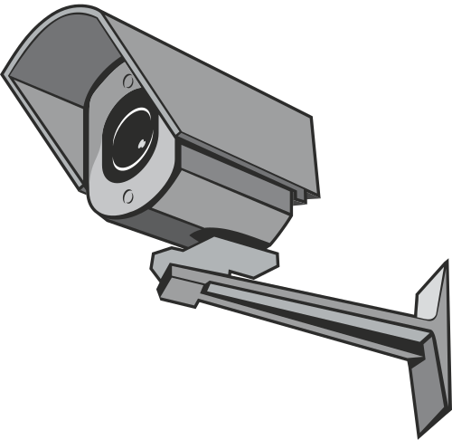
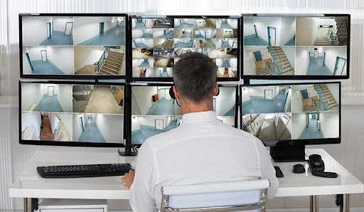
TRADITIONAL SYSTEM & PROBLEMS
  CCTV CAMERAS WITH MANUAL MONITORING
  No automatic threat detection
  Human error and fatigue
  Reactive instead of proactive system

Slide 4

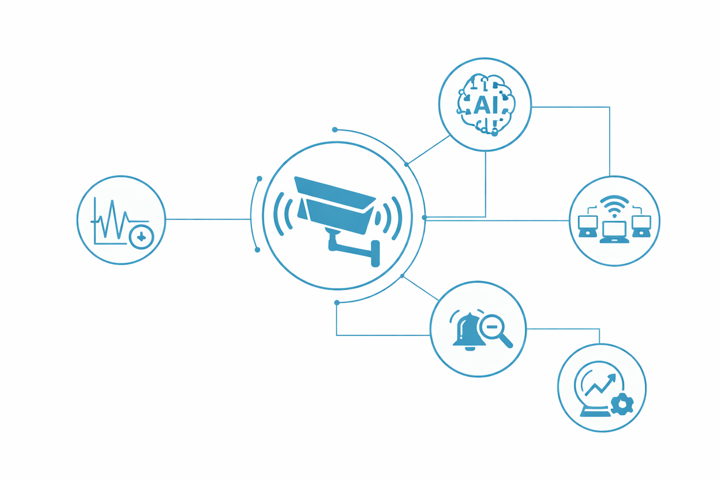

WHAT IS SMART SURVEILLANCE?
Integration of CCTV + AI + IoT + Cloud
Real-time video analytics
2M
100K
Automated detection & alerts
Intelligent and predictive monitoring

Slide 5


TECHNOLOGIES USED
• AI & Deep Learning
• Machine Learning Algo
• Computer Vision
• Edge & Cloud Computing
• Big Data Analytics

Slide 6
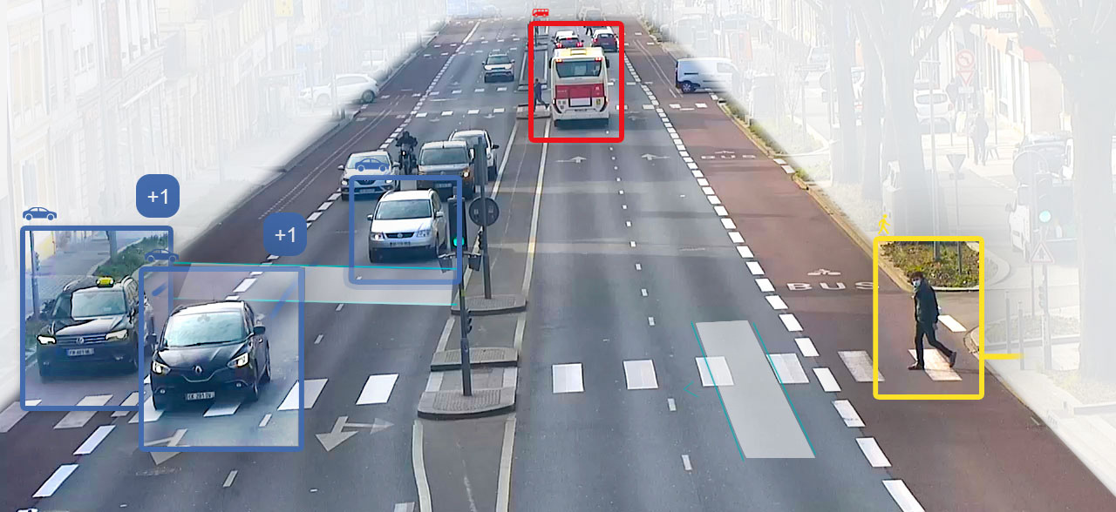
APPLICATIONS
• Delhi Smart City Surveillance Network
• AI based monitoring at Delhi Airport
• Traffic AI cameras in major Indian cities
• Railway station surveillance systems
• Bank & ATM monitoring

Slide 7
ADVANTAGES
• 24/7 Automated Monitoring
• Faster threat detection
• Reduced manpower cost
• High accuracy using AI
• Remote access & cloud storage

Slide 8
DISADVANTAGES
• Privacy concerns
• High implementation cost
• Cybersecurity risks
• Ethical & data misuse issues

Slide 9
CONCLUSION
  Smart surveillance is transforming modern security
  AI enables proactive threat detection
  Strong data protection laws required
  Future-ready intelligent infrastructure

Slide 10

THANK YOU

